Slide 1

Interpersonal Skills
Personal Development
Communications
Relationship Skills
Soft skills
Skill
Language
Non-verbal behaviour

Slide 2
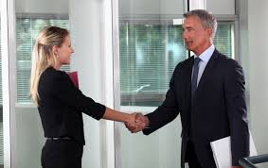
Meeting and interacting with others.

Slide 3

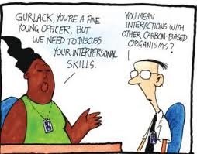
Soft Skills
The importance of interpersonal skills cannot be understated.
Soft skills repertoire includes EI, team player attitude, growth mindset, work ethic, willingness to learn, empathy, open-mindedness

Slide 4
Communication and Interpersonal Skills
Non-mediated Interpersonal communication is an interlocking social, cognitive, affective, linguistic & non-verbal experience
Communication is central (crucial) to the success of business and personal lives
As a social skill, some people are better social inter-actors than others
There are many models

Slide 5
The Idea of Skill- no consensus among social scientists - ability”, “competence”, “knack”, “aptitude” and “talent”, learnable and transferable?
Analytical Skills-
Critical thinking, Data analysis, Numeracy, Reporting, Research, Troubleshooting
Student skills
Accountability, Analysing information, Communication Critical thinking, Digital literacy,
Follow directions, Imagination, Initiative, Organization, Problem solving, Questioning Reading, Time management, Writing
Leadership and Management Skills
Advising, Coaching, Conflict resolution, Decision-making Delegating, Diplomacy, Interviewing, Motivation, People management
Problem solving, Strategic thinking

Slide 6
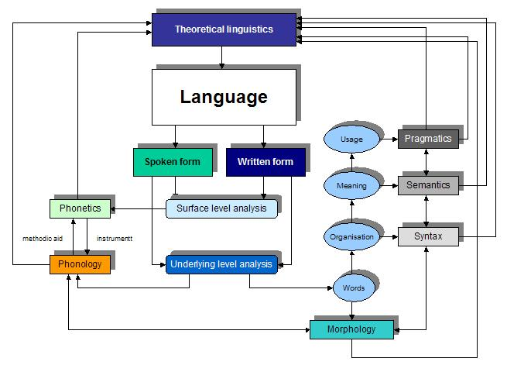
Language and Communication

Slide 7
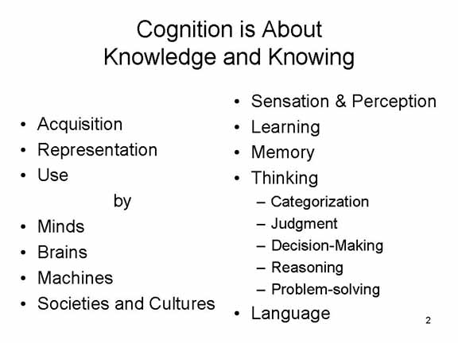
Cognition
Cognition:
Cognition (n.) mid-15c., cognicioun, “ability to comprehend, mental act or process of knowing”, from Latin cognoscere “to get to know, recognize,” from assimilated form of com “together” + gnoscere “to know” …

Slide 8
Cognition
Cognition usually refers to the mental processes of knowledge acquisition encompassing processes such as attention, the formation of knowledge, memory, working memory, judgement and evaluation, reasoning, problem-solving & decision-making, comprehension, & language production

Slide 9

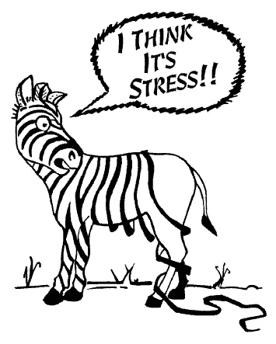
The idea of ‘affect’ Any experience of feeling or emotion, ranging from suffering to elation, from the simplest to the most complex sensations of feeling, and from the most normal to the most pathological emotional reactions. Often described in terms of positive affect or negative affect, both mood and emotion are considered affective states. Along with cognition and conation, affect is one of the three traditionally identified components of the mind. The part of mental life having to do with striving, including desire and volition is called conation.

Slide 10
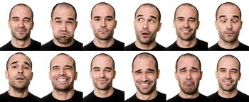
Non-verbal Communication

Slide 11
NVC
Non-verbal behaviour and non-verbal communication
Kinesics – body movements/body language - gestures
Facial expression – eye behaviour/eye contact
Haptics – touching behaviour
Occulesics
Proxemics - distance
Paralanguage and prosody – aspects of the voice-voice quality of voice, rate, pitch, loudness & rhythm, intonation and stress
Chronemics
Posture

Slide 12
Actors and Context
The physical environment: home (the bedroom), theatre, retail outlet, building site, office, workshop,etc.
The ‘emotional’ environment: serious, formal, informal, tense, relaxed, hostile, sad, happy,etc.
The task(s):cognitive, physical, training, learning, composite, etc.

Slide 13
Actors and interpersonal communication
Physique- physical size, shape, attractiveness, etc.
Age – young, adolescent, adult, OAP
Gender
Social Class; socio-economic status
Life Role (profession, etc.)
Culture – norms, traditions, expectations
Ethnicity

Slide 14
Actors and interpersonal communication
Social identity – perceived social group
Personality - OCEAN
Self-concept
Experience
Skills
Knowledge (declarative & procedural)
Communicative competence

Slide 15
Actors and interpersonal communication
Opinions
Beliefs
Attitudes
Values
Personal myths
Motivation
Disposition

Slide 16
Actors and interpersonal communication
Intelligence (g, Gcr, etc.)
Cognitive style
Learning style – VAK, etc
Decision-making skills
Problem-solving skills
Socialisation
Behaviour (aggressive, passive, assertive)

Slide 17
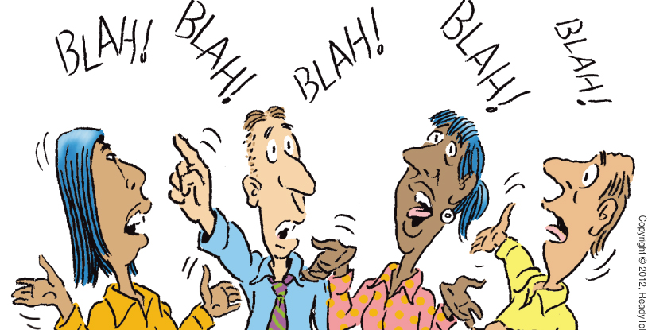
Blah blah blah blah

Slide 18
Physical Appearance- the body as NVC How can physical appearance affect interactions with others?
Physical appearance as NVC code
Physical attractiveness- impact on culture and interpersonal comms
The Body
Body type and shape, weight, height and status, the disabled (differently-abled) body, skin colour, body smell/odour, hirsuteness
Clothing – personality and culture
Artifacts-Jewelry, eyeglasses makeup (cosmetics)
Body modification – piercings, tattoos, cosmetic procedures

Slide 19
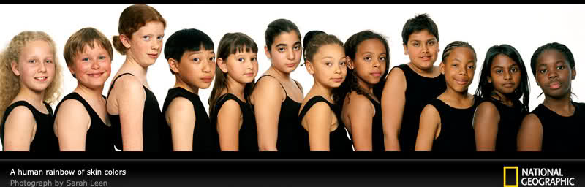
Physical Appearance

Slide 20
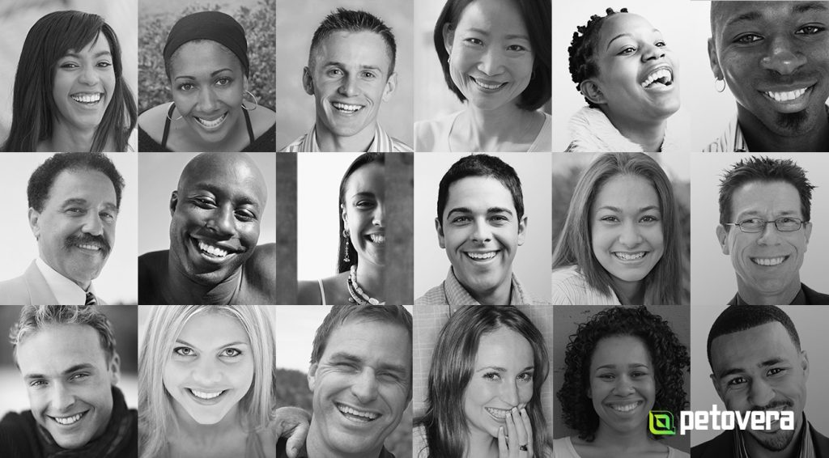

Slide 21
Age- ageing From youth to old age
Age
Childhood, adolescence, young adulthood, middle age and old age
How does age affect communication? What are needs of people as they grow older?
How do age differences be a barrier to communication?
Why is age connected to communication?
What is the influence of age to communication?
How do I overcome an age difference communication barrier?
Is age a communication barrier between teachers and students? If yes, what can be the reasons, and how can we overcome them?

Slide 22
Gender
Gender typically refers to the characteristics of women, men, girls and boys that are socially constructed. This includes norms, behaviours and roles associated with being a woman, man, girl or boy, as well as relationships with each other. As a social construct, gender varies from society to society and can change over time.
Gender is prototypically hierarchical and engenders inequalities that intersect with other social and economic inequalities. Gender-based discrimination intersects with other factors of discrimination, such as ethnicity, socioeconomic status, disability, age, geographic location, gender identity and sexual orientation, among others.

Slide 23
Gender
Gender interacts with but is different from sex, which refers to the different biological and physiological characteristics of females, males and intersex persons, such as chromosomes, hormones and reproductive organs.
Gender and sex are related to but different from gender identity. Gender identity refers to a person’s deeply felt, internal and individual experience of gender, which may or may not correspond to the person’s physiology or designated sex at birth.
Gender influences people’s experience of and access to many domains including for example healthcare. The way that health services are organized and provided can either limit or enable a person’s access to healthcare information, support and services, and the outcome of those encounters. Health services should be affordable, accessible and acceptable to all, and they should be provided with quality, equity and dignity.

Slide 24
Gender
Gender inequality and discrimination faced by women and girls puts their health and well-being at risk. Women and girls often face greater barriers than men and boys to accessing health information and services. These barriers include restrictions on mobility; lack of access to decision-making power; lower literacy rates; discriminatory attitudes of communities and healthcare providers; and lack of training and awareness amongst healthcare providers and health systems of the specific health needs and challenges of women and girls.
Harmful gender norms – especially those related to rigid notions of masculinity – can also affect boys and men’s health and wellbeing negatively

Slide 25
Social Class – Socio-economic status
Socioeconomic status (SES) encompasses not just income but also educational attainment, financial security, and subjective perceptions of social status and social class. Socioeconomic status can encompass quality of life attributes as well as the opportunities and privileges afforded to people within society. Poverty, specifically, is not a single factor but rather is characterized by multiple physical and psychosocial stressors. (APA – 2020)
Perception by others, physical and mental health, exclusion, discrimination, educational attainment, wealth, living conditions, gender & SES, etc

Slide 26
Life Role – profession, occupation, job, career
Medical doctor
Architect
Dentist
Engineer (civil, electronics, electrical)
Artist, actor, poet, musician
Journalist
Business person/ manager
Carpenter, electrician, bricklayer
Semi-skilled worker, unskilled worker
Unemployed

Slide 27
Culture and socialisation
Socialization: the process by which individuals are made aware of the expectations, others have of their behavior, by which they acquire the norms, mores, values and beliefs of a social group or society and by which the culture of a social group or society is transmitted/exchanged.
Norms: shared expectations or standards of behavior within a particular group or society
Values: shared attitudes of approval and disapproval/judgements
Mores: social rules, conventions

Slide 28
Culture
Culture is ‘constructed’
Symbols, Traditions, rituals, rites, heroes, festivals, history, achievements, failures, ‘the other’, national identity, ‘national persona’, schemas and scripts, ‘the way we do things around here’, real vs. perceived, espoused vs. in-action, what we say we do/are vs. what we really/actually do/are, ideology, preferences, philosophy, values, norms,
What do you believe? Why do you believe this?, etc.

Slide 29
Culture
Culture is not innate but learned
Experience, observation, replication, duplication, socialization (primary, secondary, tertiary, etc.,), education, practice, indoctrination, play, enculturation, nurture, acquisition, tolerances, acceptance and assumption,
Ontology-

Slide 30
Culture
Culture is cumulative
Year-on-year accumulation of novel traits, ideas, technologies, practices, fashions, adaptations,
Culture can also forget!!! Loss of language
Major social and cultural upheavals
Maya civilization , Indus Valley Civilization, Khmer Civilization, etc.
Culture is prescriptive and proscriptive
What we must and mustn’t do!!!
Rewards and punishments including promotion, celebration, hero-worship vs. ostracism, stigmatism, expulsion, incarceration, excommunication, death
Heresy – apostasy,

Slide 31
Culture is shared socially, communicated and reinforced by members
Intergenerational socialization of values, norms, mores, beliefs, preferences, hopes and dreams, hatreds, assumptions, history, ‘the other’ folk devils, religion and ideology, practices,- family, social groups, work groups and teams, clubs, church, synagogue, mosque, play, games,
Rewards and punishments for successes and failures and compliance and flouting

Slide 32
Culture is multifaceted – has many faces, facets, layers, sides, etc.
Multilayered
The iceberg of culture (see image)
Universals, particulars
Practices, beliefs, ‘things’, sports, favoured colours, music
The visible and the invisible
The audible and inaudible
The intelligible and the unintelligible

Slide 33
Culture ‘is’ gratifying and resistant to change
Culture can change, changes, has changed and probably will change
Circumstance for change????
Technology, globalization, war, famine, trends, invasion, annihilation,
The idea from biology of ‘osmosis’ fast or slow-the baseball cap

Slide 34
Ethnicity
A named social category of people who identify with each other on the basis of shared attributes that would appear to distinguish them from other groups
Here we are talking about a common set of traditions, ancestry, history, nation, culture, religion
Ethnicity can be inherited…
Member ship of an ethnic group is often defined in terms of cultural heritage, ancestry, origin myth, history, homeland, language and dialect and religion, mythology, rituals, cuisine, clothing styles art, & physical appearance

Slide 35
Race
Race is a social construct and is typically essentialist in nature
Race has NO inherent physical or biological meaning
There is only ONE human race

